Slide 1

SESHADRI RAO GUDLAVALLERU ENGINEERING COLLEGE
Department of Computer Science and Engineering
MINI PROJECT
On
A Dashboard For Services Utilization At Airport Using IoT Analytics
By
19481A05M9 – S. B. Mukesh
19481A05O9 – V. Teja Sri
19481A05K1 – P. Praveen Kumar
Under the Guidance of
Mr. J. N. V. R. Swarup Kumar

Slide 2
ABSTRACT
It is difficult to analyze which resources are in high demand in public places. Barcode is a visual representation of information. By using barcodes present on the government authorized identities authorities can analyze which service has maximum demand can moderate the resources.

Slide 3



OBJECTIVE
At the end of project able to visualize the usage of services in a particular airport .

Slide 4
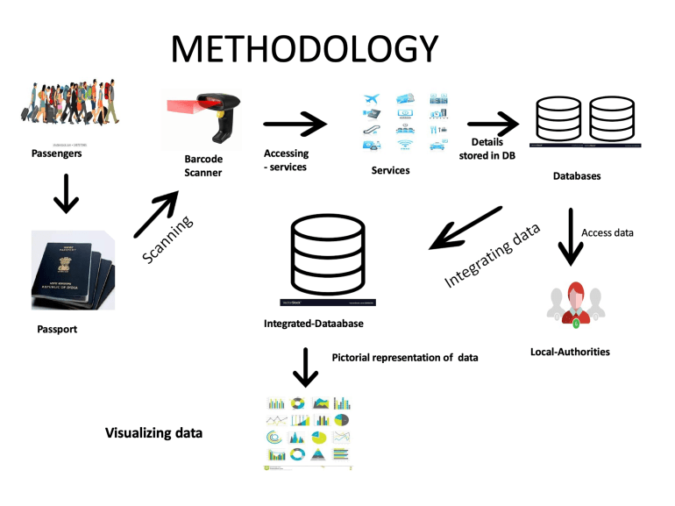

Slide 5
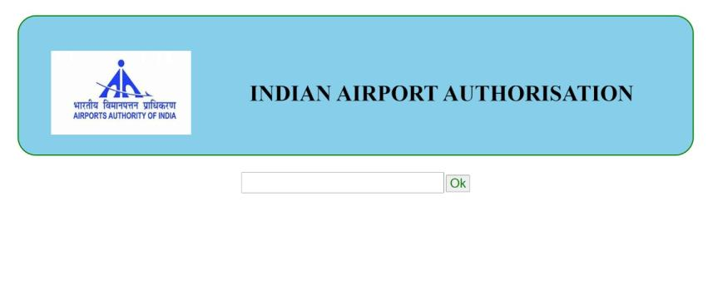
IMPLEMENTATION

Slide 6

Any Queries

Slide 7

Thank You

